Slide 1
Windows Narrator: What’s new in Windows 10 Carolina Hernandez Windows Accessibility PM Brett Humphrey Windows Accessibility PM

Slide 2


Microsoft Mission, continued
Microsoft Mission
Empower every person and every organization on the planet to achieve more

Slide 3

How we think about Disability
Disability
Disability
=
Personal health condition
Mismatched human interactions

Slide 4




Windows has embraced the journey
vision
hearing
physical
cognition
Make your device easier to see or use without a screen.
Make your device easier to hear or use without sound.
Make your device easier to use of you have limited reach or strength.
Make it easier to focus and get things done with Windows.

Slide 5
Our screen reader journey
Needed
Wanted
Loved

Slide 6
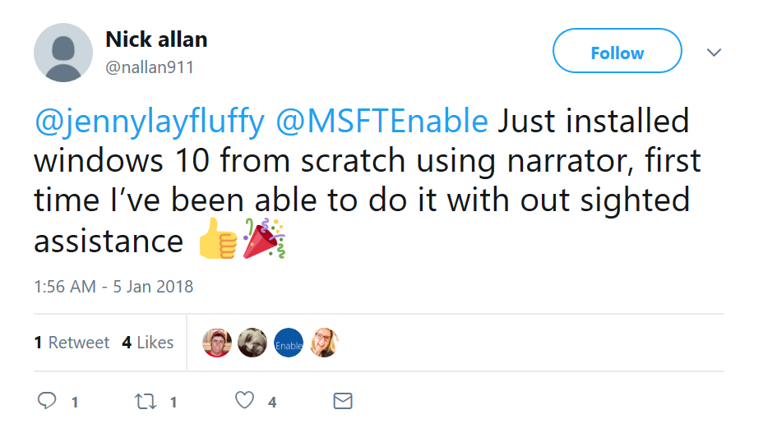
Windows 10 journey recap
Faster, more reliable & accurate
Easier to use
Faster voices
Braille beta
Unassisted installation
Better Edge browsing, including for other screen readers
Better Windows & app experiences

Slide 7
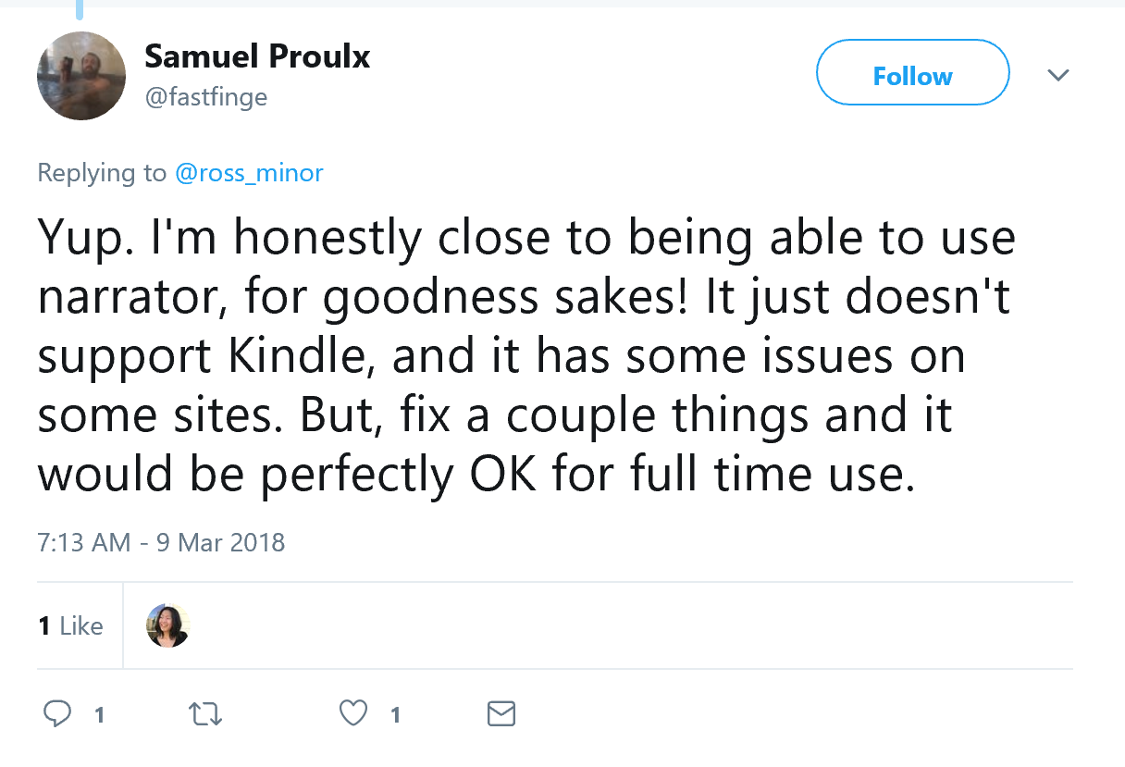
Windows 10 Coming release
Designed from the start across all Windows and App experiences
Stronger foundation
Easier to use
Braille improvements
3rd party AT partnerships

Slide 8
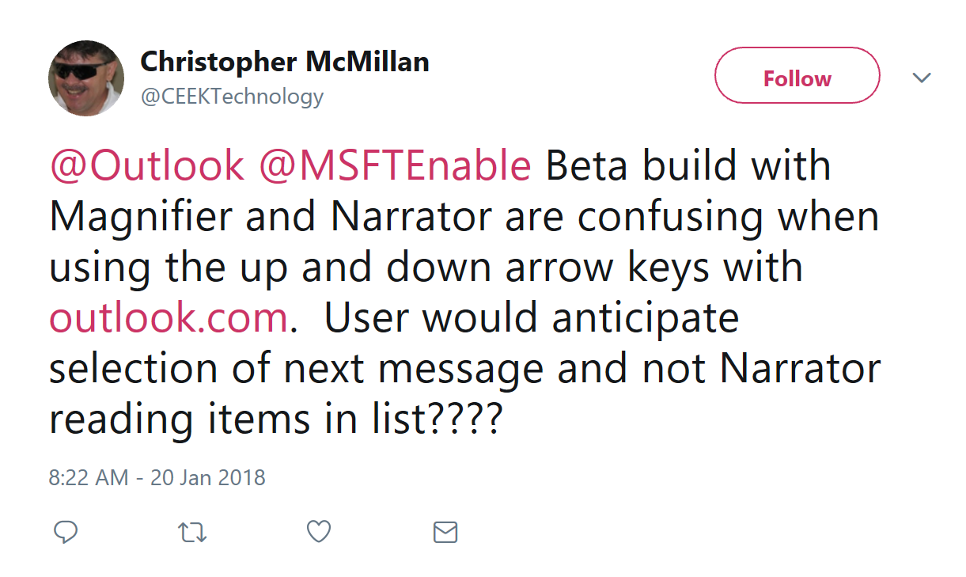
We still have more to do

Slide 9
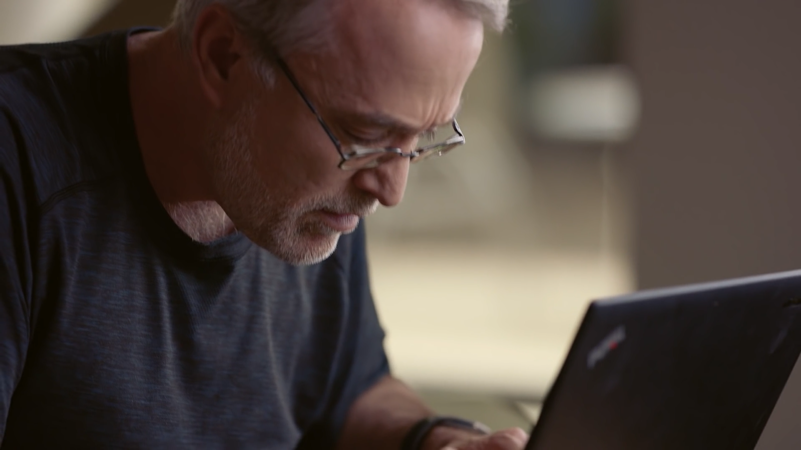


Narrator Demonstration
Narrator Demonstration
See and hear Narrator in action

Slide 10
Join us in our journey
Become a Windows 10 Insider
Try Narrator
Give us feedback
Go to https://insider.windows.com to learn how to get preview versions of Windows 10
Try Narrator for browsing the web in Edge, reading your mail or use your favorite modern apps
Press CAPS LOCK Key + E to launch the Feedback Hub and share how we can improve
Aka.ms/AccessibilityFeedback

Slide 11
Resource Links
Microsoft at CSUN
aka.ms/CSUN2018
Answer Desk for Accessibility Support
aka.ms/eDAD
Microsoft Accessibility Overview
Microsoft.com/Accessibility

Slide 12
We want to hear from you.
Connect with us in person today or anytime through our support and feedback channels.
Disability Answer Desk for phone/chat/ASL Help: Aka.ms/AccessibilitySupport
User voice Forum for Accessibility Feedback: Aka.ms/AccessibilityFeedback

